Slide 1
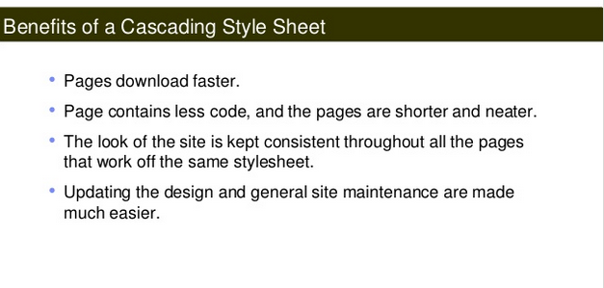
CSS

Slide 2
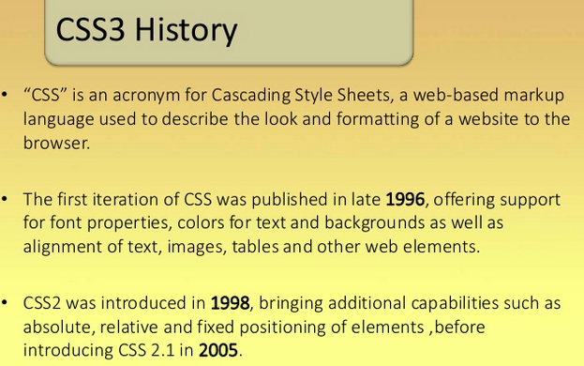
CSS3 History

Slide 3
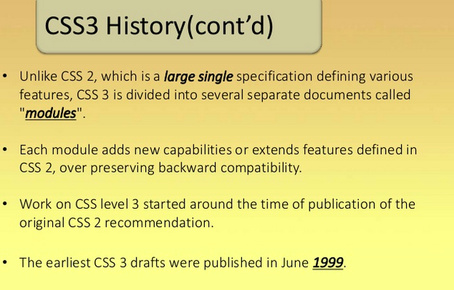
CSS3 History

Slide 4
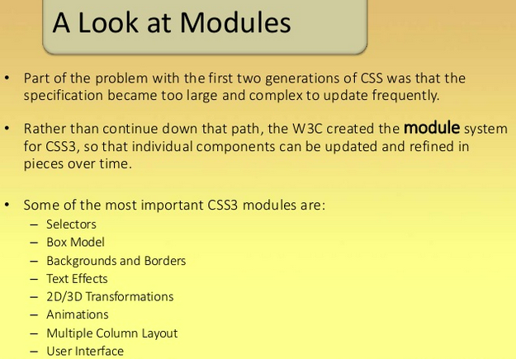
CSS3 Modules

Slide 5
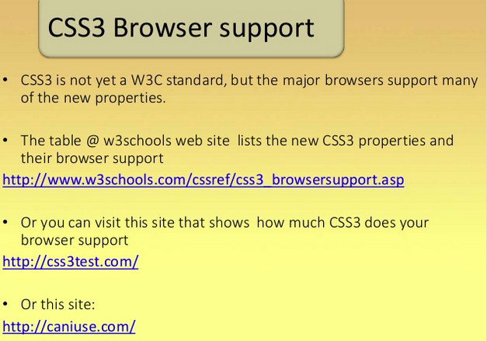
Browser Support

Slide 6
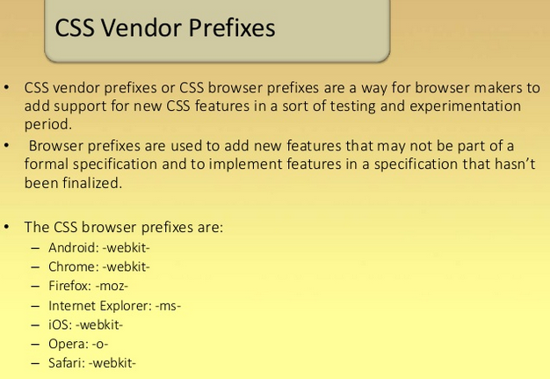
CSS Vendor Prefixes

Slide 7
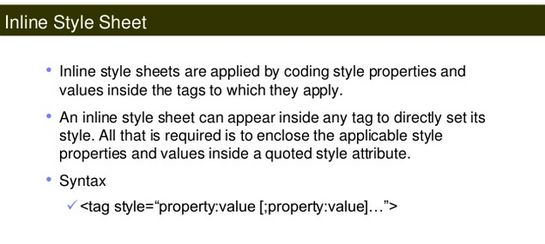
Inline Style Sheets

Slide 8
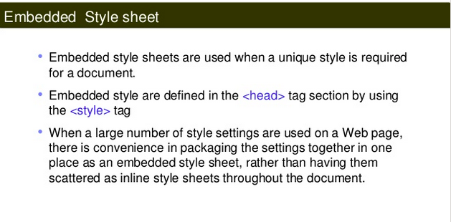
Internal Style Sheets

Slide 9
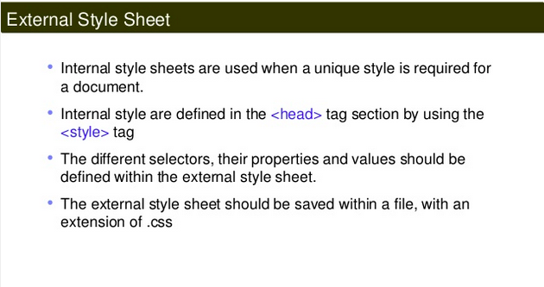
External Style Sheets

Slide 10
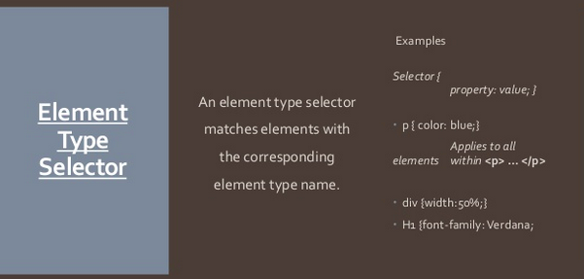
Selector Types – Element Type

Slide 11
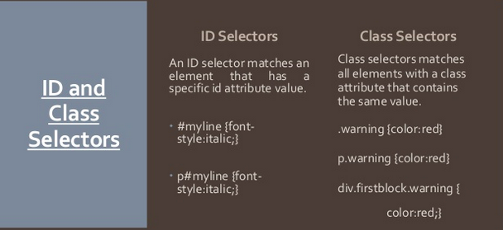
Selector Types – ID and Class

Slide 12
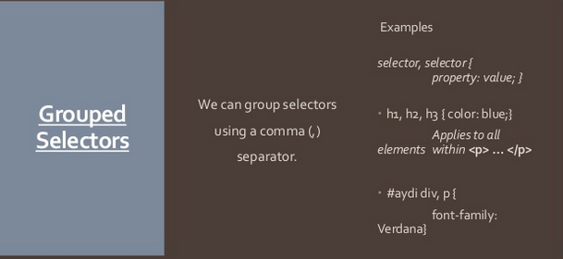
Selector Types - Grouped

Slide 13
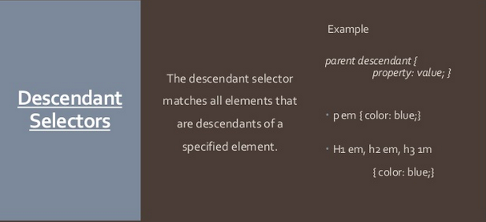
Selector Types - Structural

Slide 14
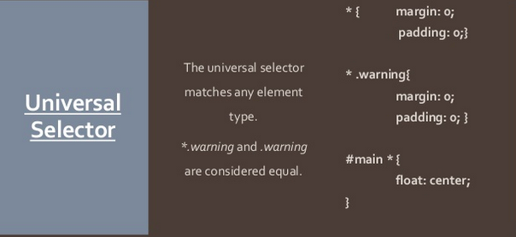
Selector Types - Universal

Slide 15
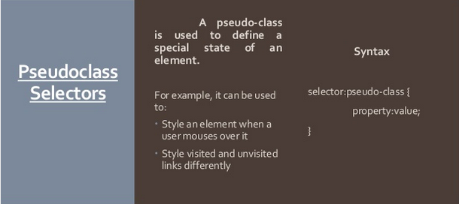
Selector Types – Pseudo class

Slide 16
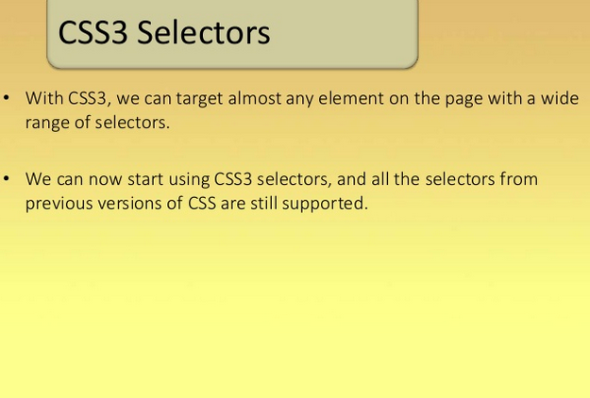
CSS3 Selectors

Slide 17
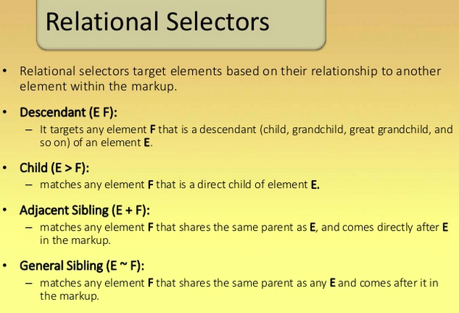
Relation Selectors

Slide 18
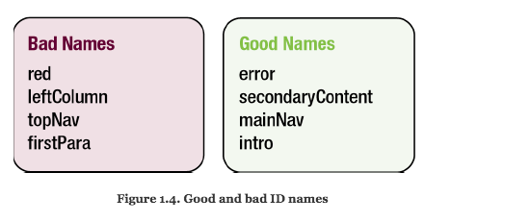
Naming Conventions

Slide 19
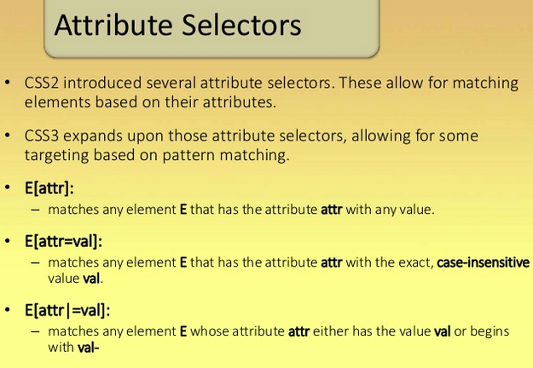
Attribute Selectors

Slide 20
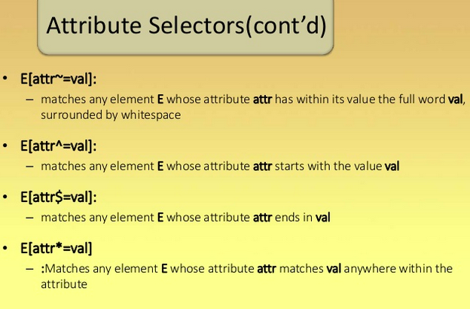
Attribute Selectors

Slide 21
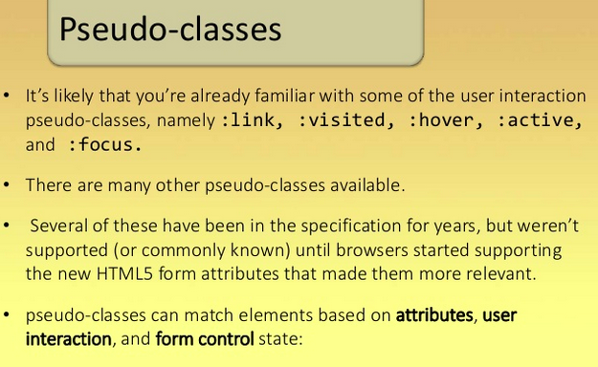
Pseudo -classes

Slide 22
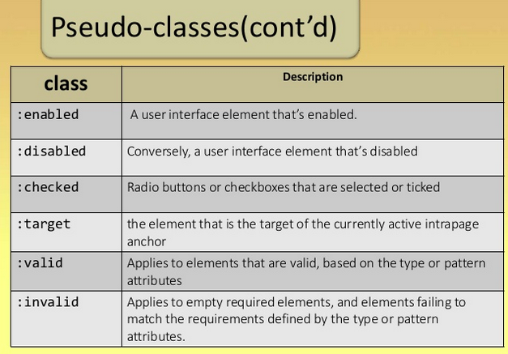
Pseudo Classes

Slide 23
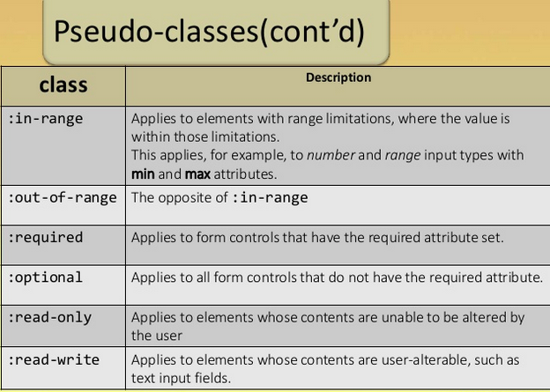
Pseudo - Classes

Slide 24
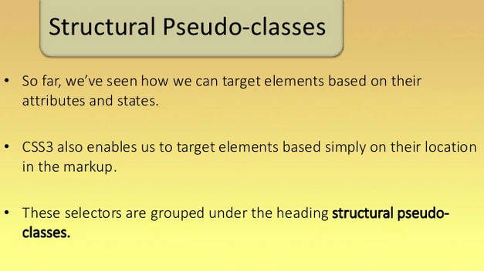
Structural Pseudo - Classes

Slide 25
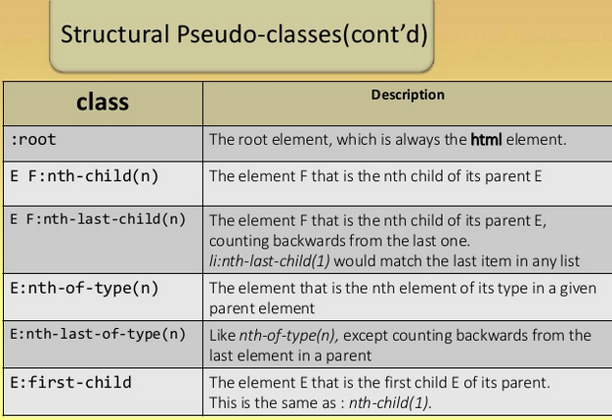
Structural Pseudo - Classes

Slide 26
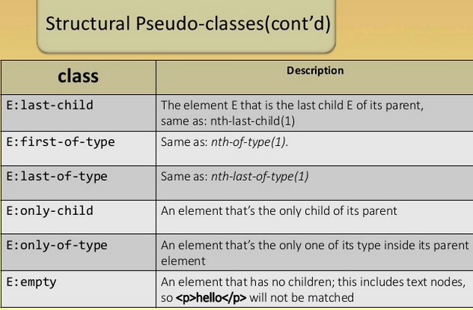
Structural Pseudo - Classes

Slide 27
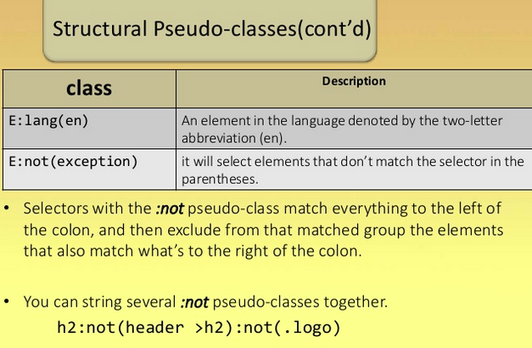
Structurl Pseudo - Classes

Slide 28
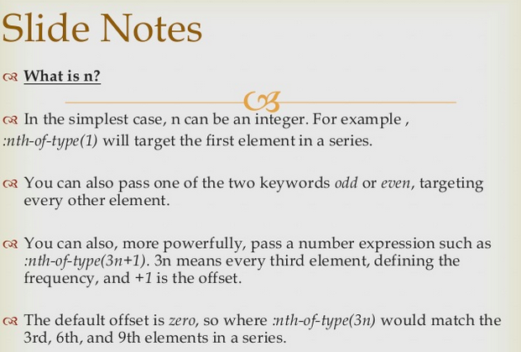
What is n

Slide 29
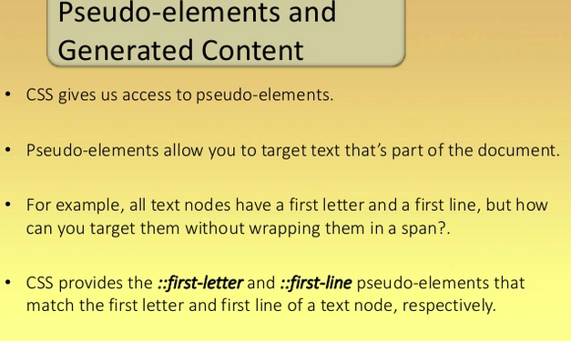
Pseudo – elements and generated Content

Slide 30
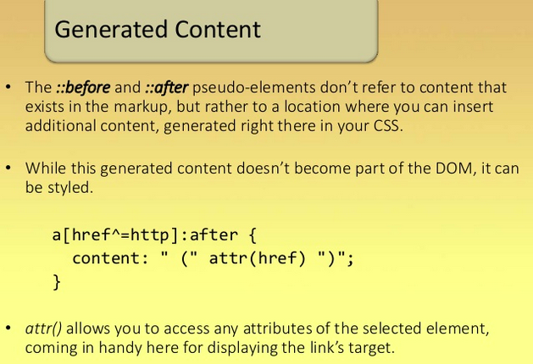
Before and After

Slide 31
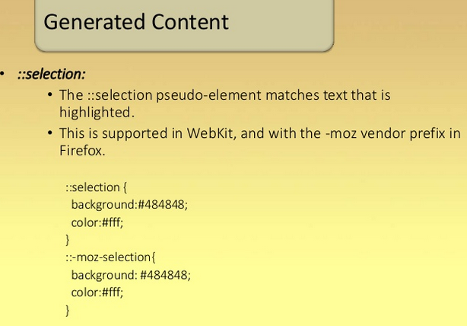
Selection

Slide 32
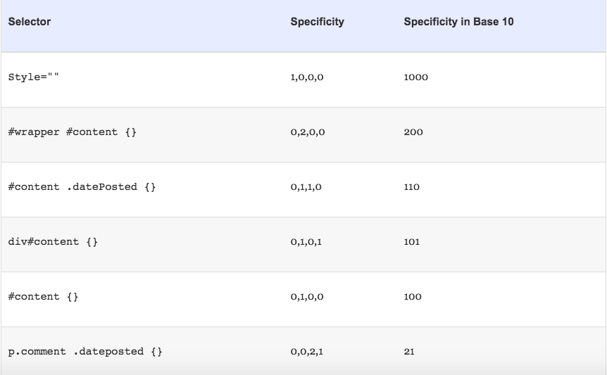
Specificity

Slide 33
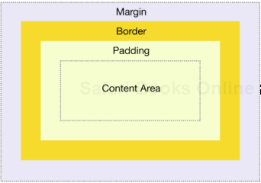
Box Model

Slide 34
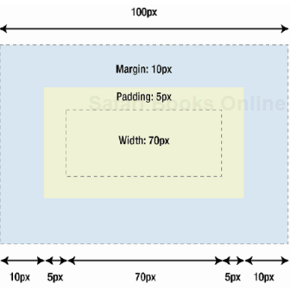
Box Model

Slide 35
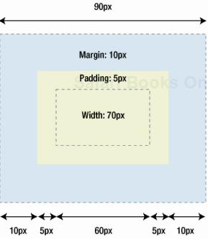
IE Box Model

Slide 36
Box-Sizing

Slide 37
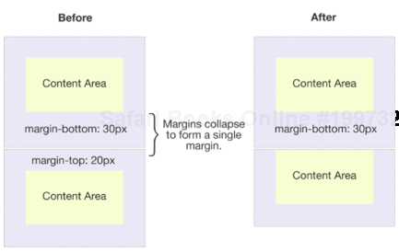
Margin Collapse

Slide 38
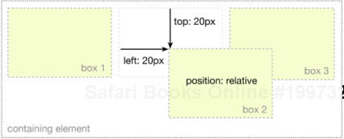
Position - Relative

Slide 39
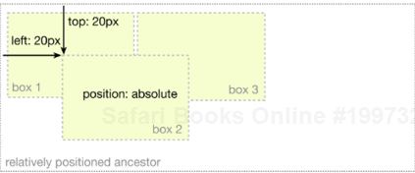
Position - Absolute

Slide 40
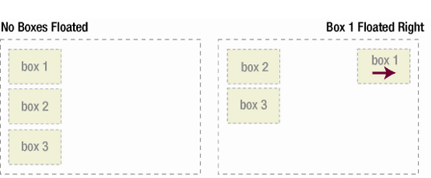
Float

Slide 41
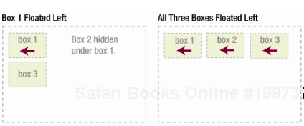
Float

Slide 42
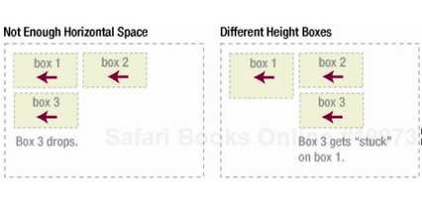
Float - Clear

Slide 43
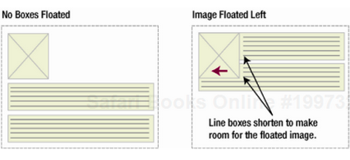
Float - Example

Slide 44
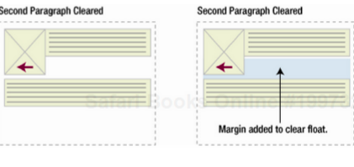
Float Example

Slide 45
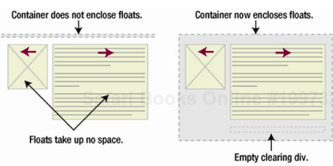
Float Example

Slide 46
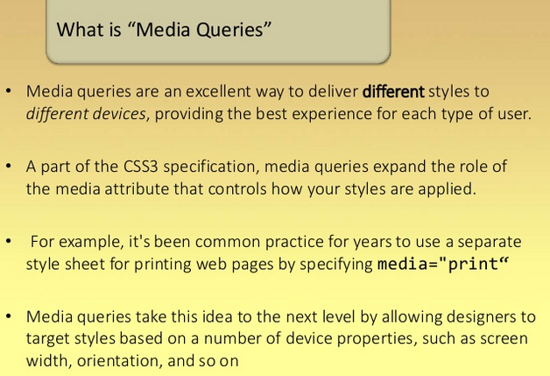
Media Queries

Slide 47
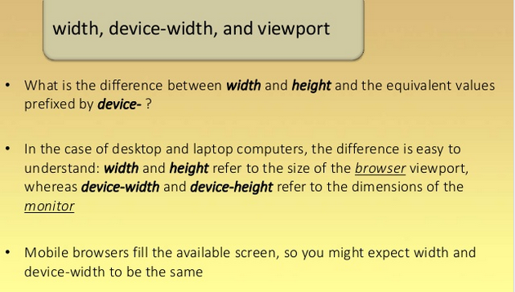
Media Queries( width - height)

Slide 48
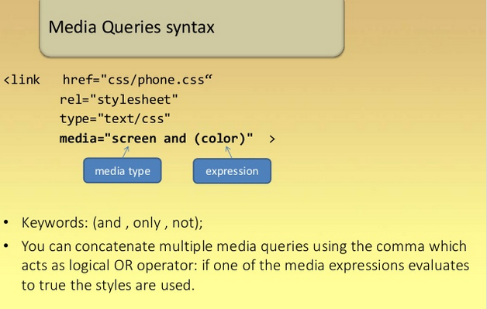
Media Queries Syntax

Slide 49
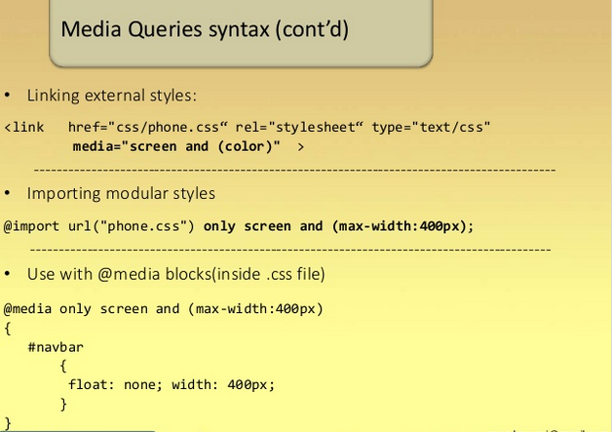
Medai Queries – 3 Ways

Slide 50
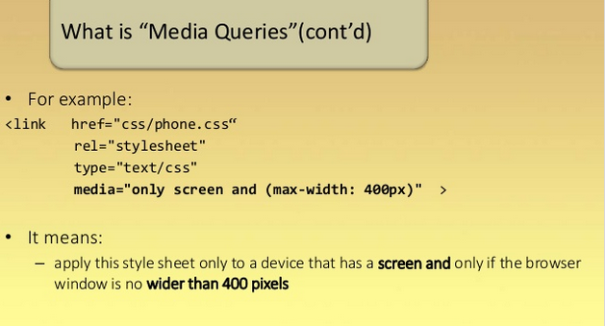
Media Queries ( example )

Slide 51
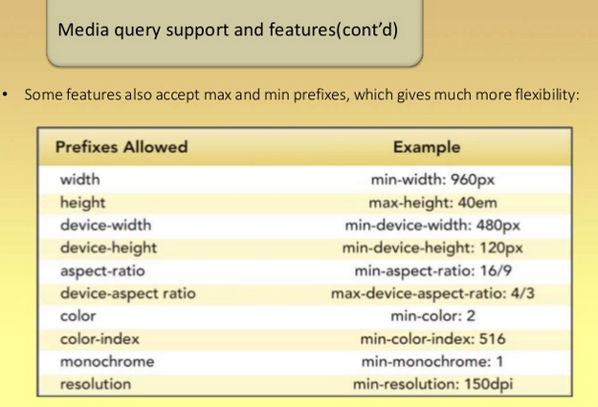
Media Queries

Slide 52

Media Queries

Slide 53

Font-face

Slide 54

Font-face ( cont’d)

Slide 55

Font face( Bold Text)

Slide 56

Shadows

Slide 57

Text Shadow

Slide 58

Borders

Slide 59


Word Wrapping

Slide 60

Gradients

Slide 61

Backgroud Size

Slide 62

Linear Gradients

Slide 63

Linear Gradients

Slide 64

Multiple Backgrounds

Slide 65

Background Origin

Slide 66

Border Images

Slide 67

CSS Multiple Columns

Slide 68

Radial Gradients

Slide 69

Radial Gradient

Slide 70

CSS3 - Transforms

Slide 71

Transforms- Skew

Slide 72

Transforms- Rotation

Slide 73

Transforms- Scaling

Slide 74

Transforms- Scaling

Slide 75

Transforms - Translation

